Slide 1
JET Audio Encoder
Taylor Autry
Eric Addison
Josh Musick

Slide 2
Overview
Compression Pipeline
Metrics Evaluated
Filter Bank
Modified Discrete Cosine Transform (MDCT)
Byte Bufferizers
Huffman Encoder
Serialization

Slide 3
Audio Compression Pipeline
Input Audio File (wav)
Modified Discrete Cosine Transform (MDCT)
Filter Bank
Line Byte Bufferizer
Sub Band Byte Bufferizer
Huffman Encoder
Serialize Data Stream
Output Compressed File (jet)

Slide 4
Metrics Evaluated
Compress / Decompress Time
Compression Ratio (input size vs output size)
RMS Error

Slide 5
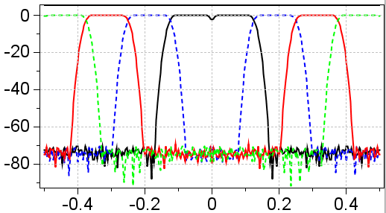
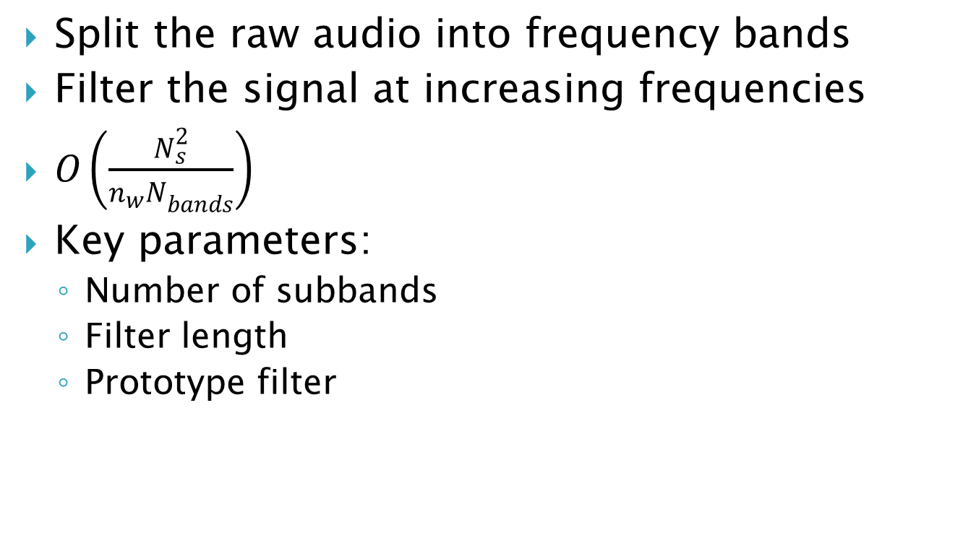
Filter Bank Step
Split the raw audio into frequency bands
Filter the signal at increasing frequencies
$O\left(\frac{N_{s}^{2}}{{n_{w}N}_{bands}}\right)$
Key parameters:
Number of subbands
Filter length
Prototype filter

Slide 6
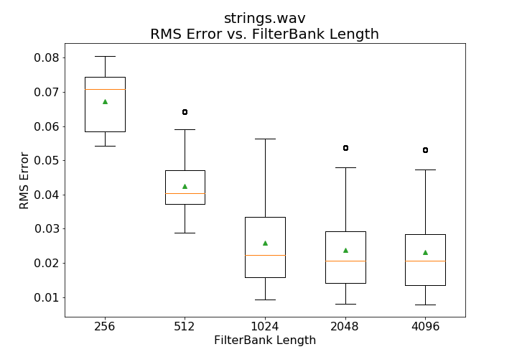
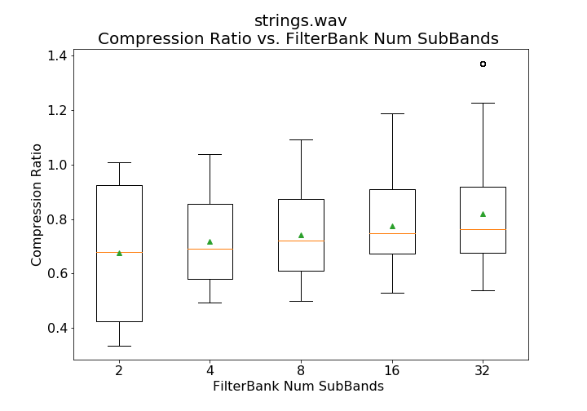
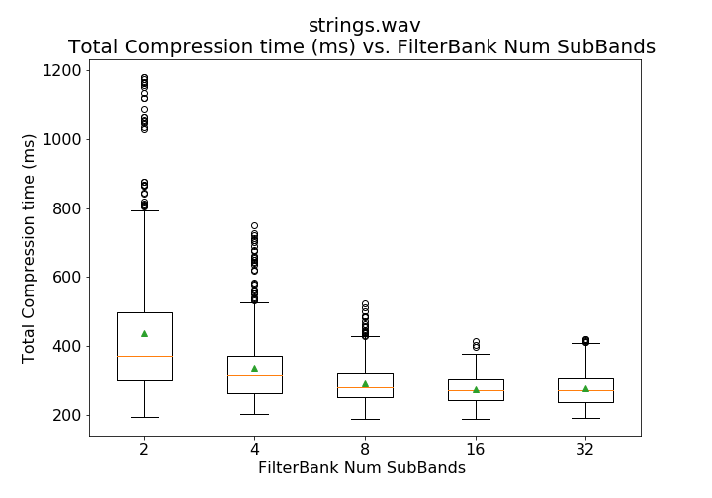
Filter Bank Step
Variable Parameters
Filter Bank Length
Number of Sub-bands

Slide 7
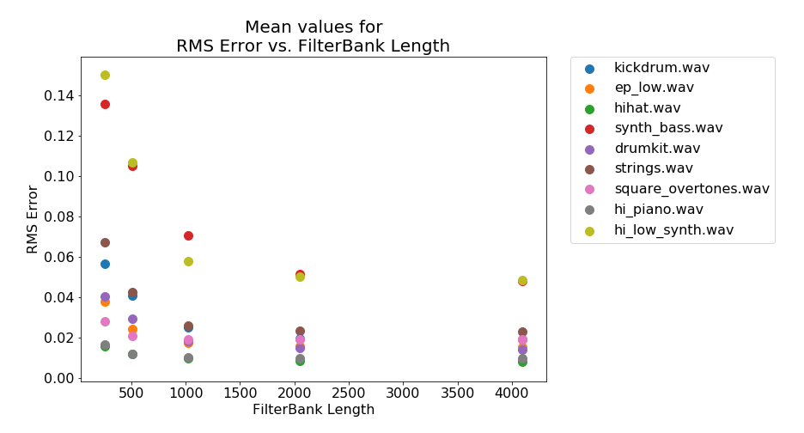
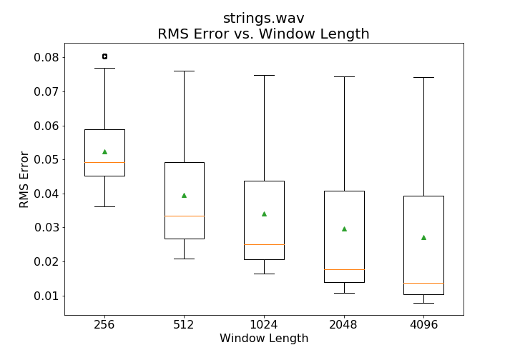
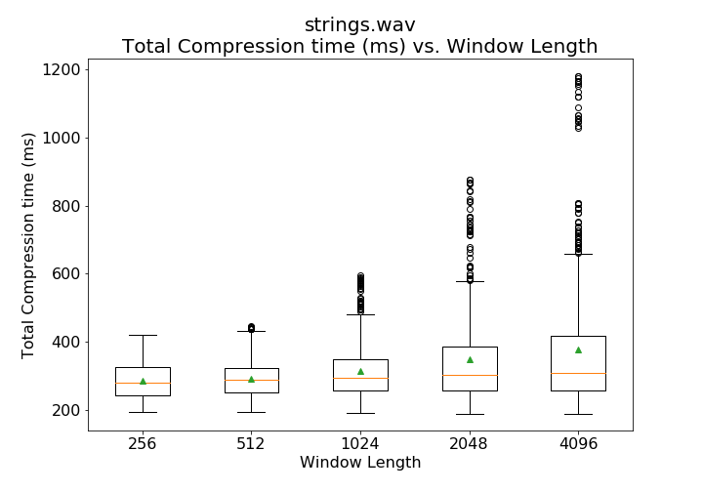
Filter Bank Step
Variable Parameters
Window Length

Slide 8
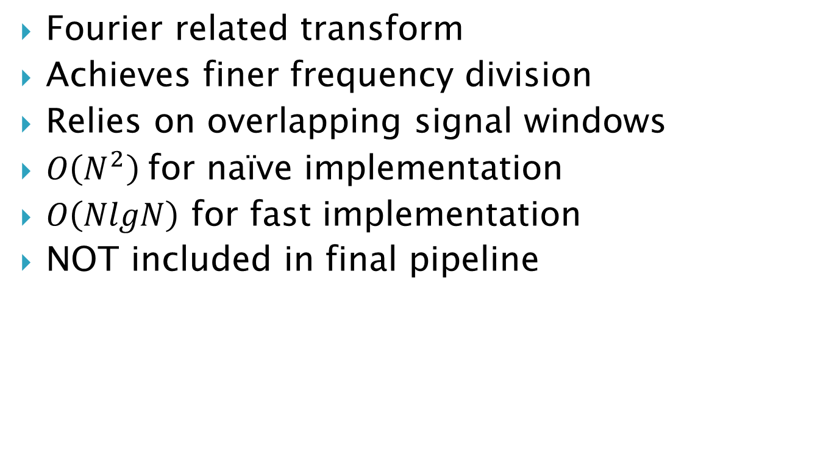
Modified Discrete Cosine Transform
Fourier related transform
Achieves finer frequency division
Relies on overlapping signal windows
$O\left(N^{2}\right)$for naïve implementation
$O\left(NlgN\right)$ for fast implementation
NOT included in final pipeline

Slide 9
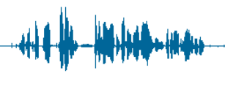
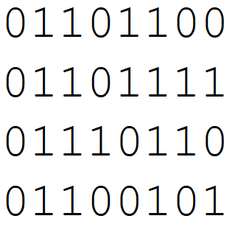
Byte Bufferizers
Transformation from signal to byte domain
Store the floats as byte-limited integers
Adaptive Version
Identify local min/max for each incoming window
Psycho-Acoustic Model
Exploit human physiology and perception to reduce the precision of and/or eliminate certain components of the signal
*** Primary source of compression!!!
Our model: cut the byte-depth outside passband

Slide 10
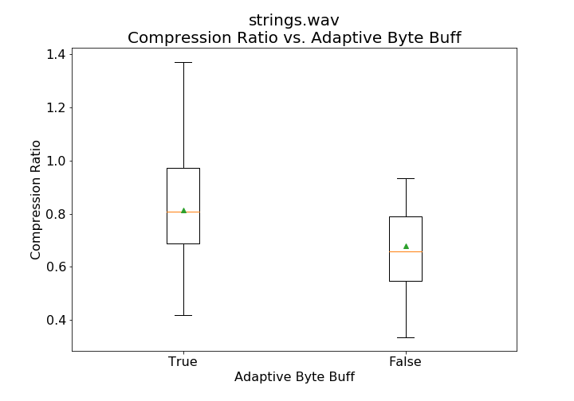
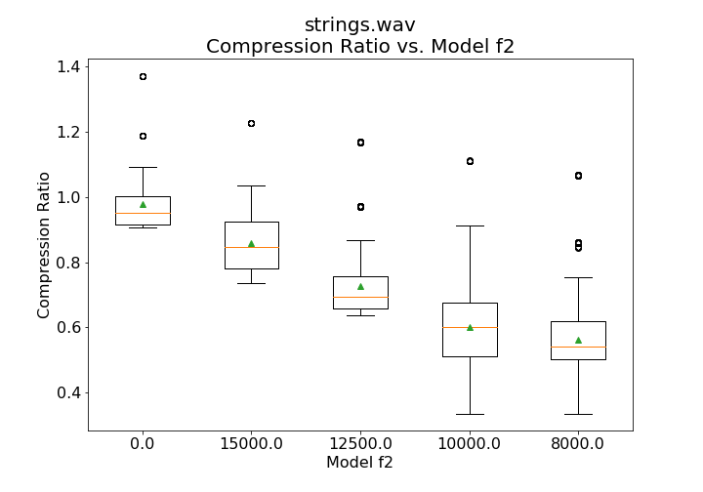
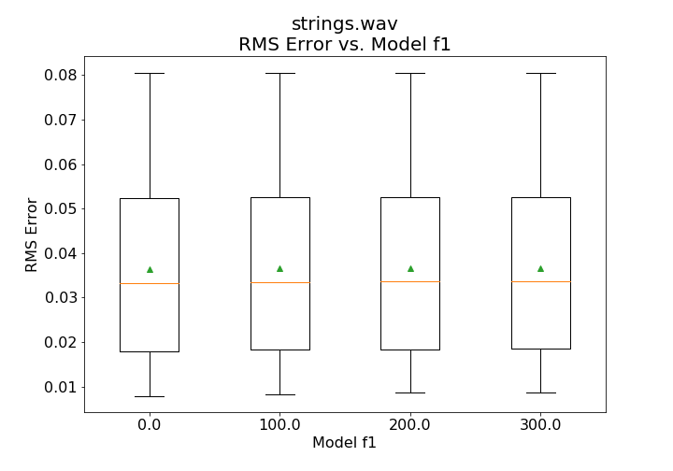
Byte Bufferizers
Psycho-Acoustic Model
Adaptive vs Non-Adaptive

Slide 11
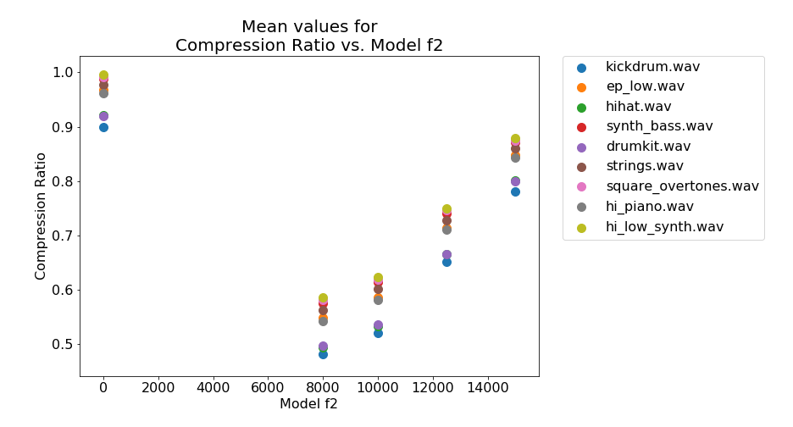
Byte Bufferizers

Slide 12
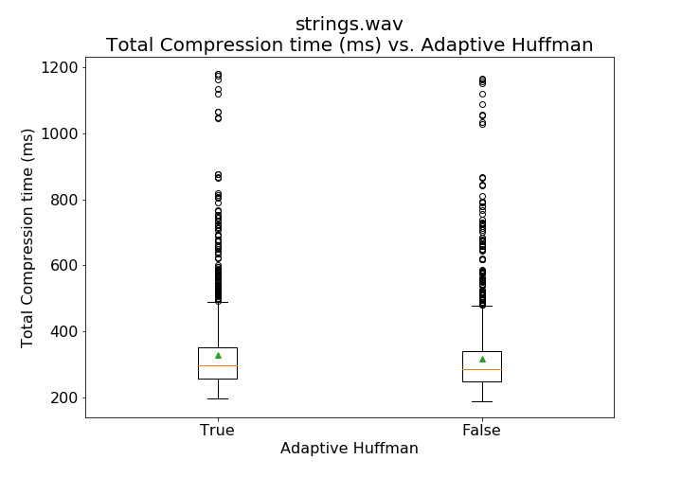
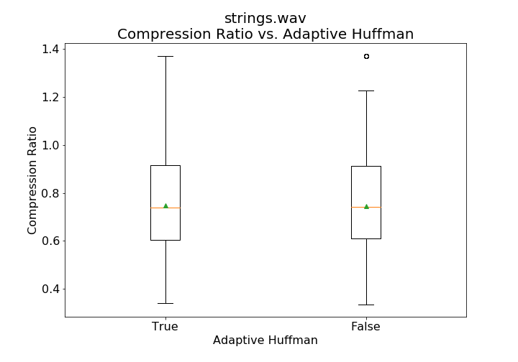
Huffman Encoder
Adaptive Encoding

Slide 13
Data Serialization
Writing data to binary file
No standard format was used
Enabled quick writing and reading

Slide 14
Summary
Compression Pipeline
Metrics Evaluated
Filter Bank
Modified Discrete Cosine Transform (MDCT)
Byte Bufferizers
Huffman Encoder
Serialization

Slide 15
Audio Samples
drumkit.wav
drumkit_bestRMS.wav
(0.004, 0.96, 512ms)
drumkit_bestCompression.wav
(0.037, 0.2, 192ms)
drumkit_bestDecompTime.wav
(0.044, 0.4, 174ms)

